Slide 1
Clarenbridge Oyster Festival 2011
Sinead Ní Mhainnín
Galway County Council

Slide 2
International Oyster Festival
Festival runs Friday – Sunday September
Marquee in Clarenbridge
Approximately 1250 attendees
Food served Friday evening, Saturday afternoon and evening and Sunday afternoon
Food provided by caterers

Slide 3
Oyster – 5000 (approx.)

Slide 4
2010 Oyster Festival
3500 kg of waste
No waste prevention
No segregation
No green awareness
Compactor on site

Slide 5
Festival 2011 – Goes Green
Well Positioned already working
with local business
Met with committee June 2011
Introduced concept of Waste Prevention
Received immediate buy in
Put systems in place to
improve performance

Slide 6
Festival 2011 undertook to:
Prevent waste where possible
Recycle cardboard, plastics, tetra pak etc.
Compost food waste
Use compostable products
Promote “Green” element to the festival

Slide 7
Launched Greening the Oyster Festival
Newspaper
Local Radio
Websites
Circulation of Publicity Materials

Slide 8
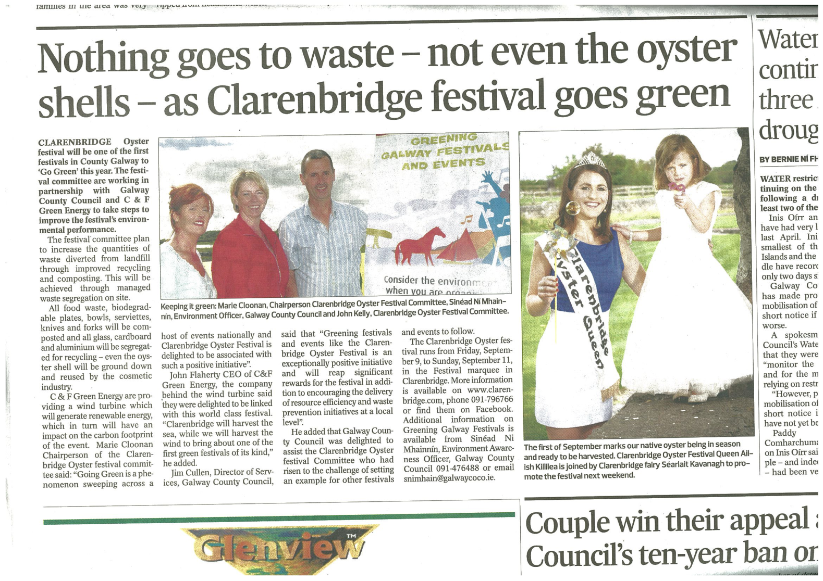
Launched Greening the Oyster Festival

Slide 9
Worked closely with:
Festival Suppliers and Caterers
Facilities Manager
Committee Members
Waste Contractor
Staff

Slide 10
Food Served on Compostable Plates
26cm Oval
220 ml Bowl
24cm Round
Coffee cup
Knife, fork and spoon

Slide 11
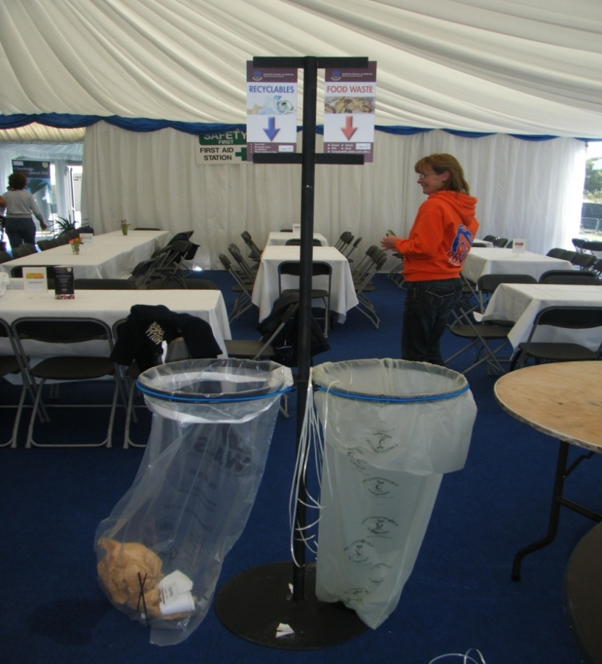
Greening Facilities - Provided Bins/Bags/Signs

Slide 12
6 frames
food and recyclables
bags changed regularly
emptied into 1100ltr bins

Slide 13
Greening Facilities - Provided Staff Training
segregation
changing bags
disposal

Slide 14
Segregation on Site

Slide 15
Waste Prevention
All condiments were supplied in large bowls
Seafood sauces, ketchup, mayonnaise, sugar, salt cellars and pepper mills
Patrons were invited to choose what they wanted from the buffet
No small wine bottles were used
One napkin with each meal

Slide 16
Results
70% Diversion from Landfill
1200 kgs of Food Waste and Compostable Products
Food waste
Compostable Products
Oyster shell
1300 kgs of Recyclables
Glass
Cardboard
Plastics
1000 kgs of Landfill
Carpet
Mixed waste

Slide 17
Lessons Learnt
Waste contractor needs to be on board
Bins need constant monitoring
Bags replaced continuously
All staff must be involved
Good quality compostable product used
MC continuously reminding patrons

Slide 18
Conclusion
Positive feedback – attendees and staff
Pilot 6 large festivals 2012
GCC considering developing an Environmental Policy that festivals must sign up to for grant aid
Arts Council consider the initiative extremely important
GCC will work with Greening future festivals

